Slide 1

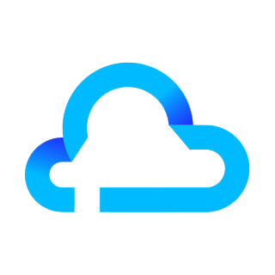
CLOUD SECURITY
Name: Parvathi Saxena
Course: M.Tech Advanced Computing & Data Science

Slide 2
CONTENTS
Introduction
Core Threats (In General)
Security Threats & Control Models
Challenges In The Cloud World
Organization Scenario
Cloud Governance
Famous Security Breaches
Conclusion
References

Slide 3
INTRODUCTION
“Cloud security is the protection of data stored online from theft, leakage and deletion.”
Key concern for CSP
Some major threats include[1],
Data Breaches
Data Loss
Account Hijacking
Poor Choice Of CSPs
DDOS Attacks
Some methods to provide security[1],
Firewalls
penetration testing
Obfuscation
Tokenization
avoiding public internet connections

Slide 4
CORE THREATS
Who are you?
COMPROMISED ACCOUNTS
CLOUD-NATIVE MALWARE
User
User
Identity
Cloud
Accounts
Apps
Device/
Network
Data
DATA BREACH
What device are you using?

Slide 5
SECURITY THREATS & CONTROL MODELS[1]
Data Encryption & Secure Key Management:
Provides Data Confidentiality and Integrity[2].
Contingency Planning:
Provides contingency plan and SLA[2].
Data center operations & maintenance:
Includes configurations, background check to allow entry into secure data center locations[2].
Media Protection:
Protects Media Files over the cloud[2].
Identification, Authentication & Authorization:
Provides Access controls to authorized users[2].
Incident Response:
Provides response plan in case of any attack or failure[2].

Slide 6

Application Security:
Overall security of the applications running on the cloud. It includes secured SDLC, authentication and authorization[2].
Portability and Interoperability:
Enable information sharing among other systems[2].
Compliance, Audit and Accountability:
Regular audits should be conducted to ensure data security[2].
Awareness & Training:
Cloud Awareness programs about threats and security controls should be conducted for the cloud consumers[2].

Slide 7
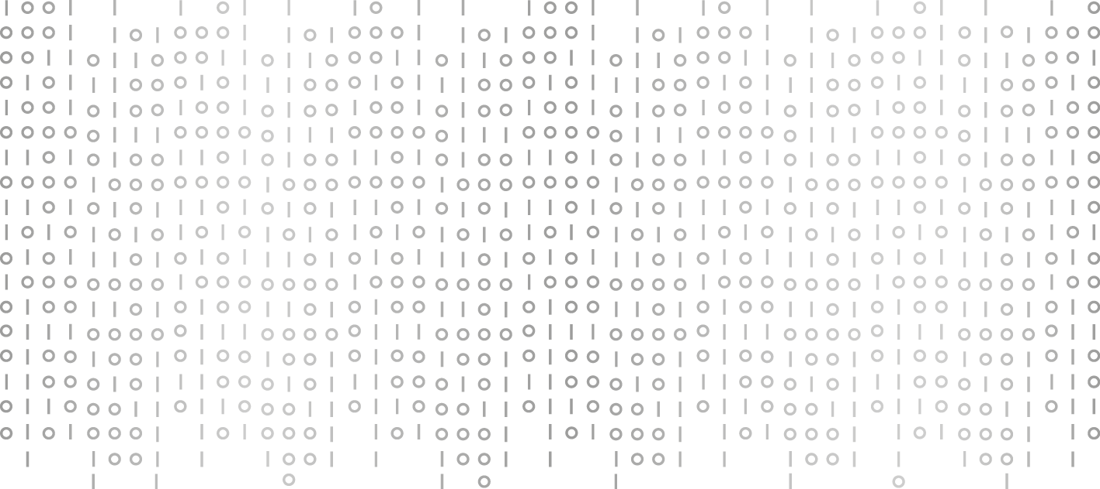
CHALLENGES IN THE CLOUD WORLD
Challenges
Data Residency
Encryption
Tokenization
Data Security
Monitoring Data
Managing Access
Gaining Visibility

Slide 8
ORANGIZATION SCEANARIO
Data Security Analyst
Assessing & Monitoring the unusual User activities
Enterprise Security Analyst
Monitors Traffic in & out of the cloud
Identity & Access Architect
Manages Access to the cloud using PIM system.

Slide 9
CLOUD GOVERNANCE
“Cloud service governance is the ability to define, track, and monitor service execution on any number of on premise and cloud computing based platforms[3].”
Benefits:
Governance and security systems work hand in hand to make sure that the information is protected and only authorized users have access[3]
Facilitates agility to manage local and cloud-based services as well as to control access to those services[3]

Slide 10
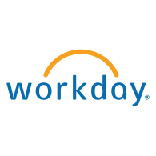
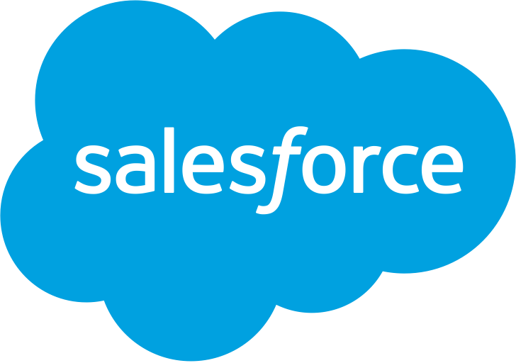
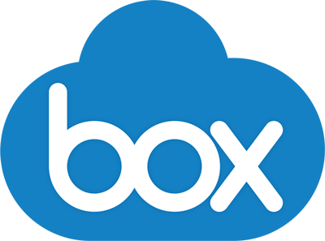
UNCLASSIFIED:
Does not fall into any of these categories
DENIED:
Prevents user from making actual mistakes
PERMITTED:
Preventing data exfiltration
APPROVED:
Large control over the service

Slide 11
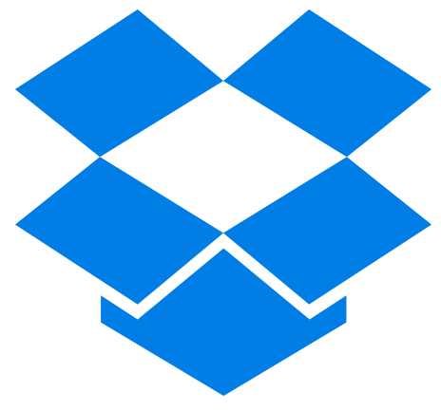

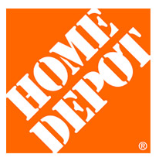
FAMOUS SECURITY BREACHES
Dropbox: In 2012, Hackers tapped into more than 68 million user. Those stolen credentials reportedly made their way to a dark web marketplace, the price for them was bitcoins. At the time, this was equivalent to roughly $1,141. Dropbox responded by requesting a site-wide password reset from the user base[4].
LinkedIn: In 2012, 6 million user passwords were stolen then published on a Russian forum. In 2016, hackers stole and posted for sale on the dark web an estimated 167 million LinkedIn email addresses and passwords. In addition to changing their passwords, LinkedIn implemented two-way authentication[4].
National Electoral Institute of Mexico: In 2016, 93 million voter registration records compromised. Most of the records were lost due to a poorly configured database that made this confidential information publicly available to anyone. Later learned that the Institute was storing data on an insecure, illegally hosted Amazon cloud server outside of Mexico[4].
Home Depot: In 2014, an attack exploited the point-of-sale terminals at the self-checkout lanes for months before someone finally detected it. The strategic affected 56 million credit card numbers. Home Depot paid out well over a hundred million dollars in lawsuit settlements and compensation to the consumers and financial institutions affected by the incident[4].

Slide 12
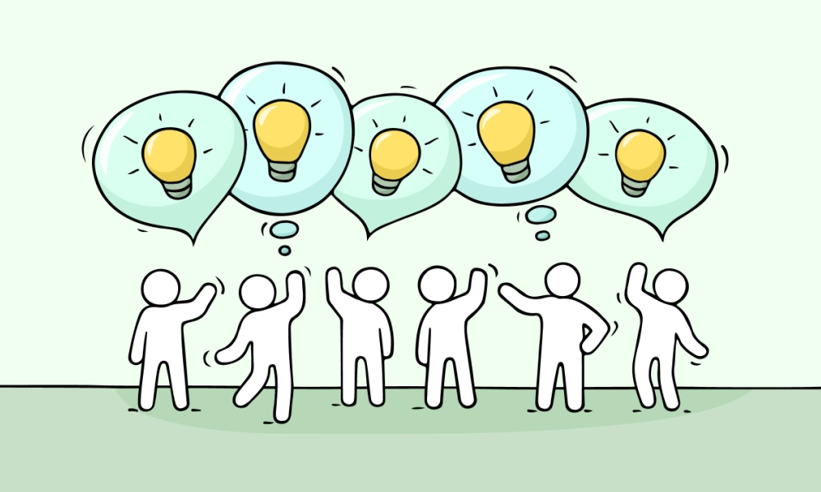
CONCLUSION
Choose your CSP wisely
Sole Responsibility of your data
Check the CSP compliance standards
Educate yourself with up-to date changes in your cloud

Slide 13
REFERNCES
D.Zhe, W.Qinghong, S.Naizheng and Z.Yuhan.”Study on Data Security Policy Based On Cloud Storage”. IEEE 3rd International Conference on Big Data Security on Cloud,2017.
A.Hendre and K.P.Joshi. “A Semantic Approach to Cloud Security and Compliance”. IEEE 8th International Conference on Cloud Computing, 2015.
D.S.Lintjicum,“The Evolution of Cloud Service Governance”, Cloud Tidbits Column, IEEE Cloud Computing, November/December 2015.
https://blog.storagecraft.com/7-infamous-cloud-security-breaches/

Slide 14


